Slide 1
Operators new and delete, recap
Operator new:
Allocates new chunk of data via operating system call. Size of the chunk is getting calculated with the formula: sizeof(T).
Operator delete:
Deallocates the chunk of the data via operating system call.
Operator new[]:
Allocates new chunk of data via operating system call. Size of the chunk is getting calculated with the formula: sizeof(T) * n
Operator delete[]:
Deallocates the chunk of the data via operating system call.

Slide 2
Operators new and delete, how it works
Operator new:
Allocates new chunk of data via operating system call. Size of the chunk is getting calculated with the formula: sizeof(T).
Operator delete:
Deallocates the chunk of the data via operating system call.
Operator new[]:
Allocates new chunk of data via operating system call. Size of the chunk is getting calculated with operator sizeof: sizeof(T) * n.
Operator delete[]:
Deallocates the chunk of the data via operating system call.
– Performed with help of an operating system

Slide 3
Operators new and delete, how it works
Operator new:
Allocates new chunk of data via operating system call. Size of the chunk is getting calculated with the formula: sizeof(T).
Calls default (or non-default) constructor.
Operator delete:
1) Calls destructor.
2) Deallocates the chunk of the data via operating system call.
Operator new[]:
Allocates new chunk of data via operating system call. Size of the chunk is getting calculated with operator sizeof: sizeof(T) * n.
Calls default constructor n times (for every object in the array).
Operator delete[]:
Calls destructor of every object in the array.
2) Deallocates the chunk of the data via operating system call.
– Performed with help of an operating system

Slide 4




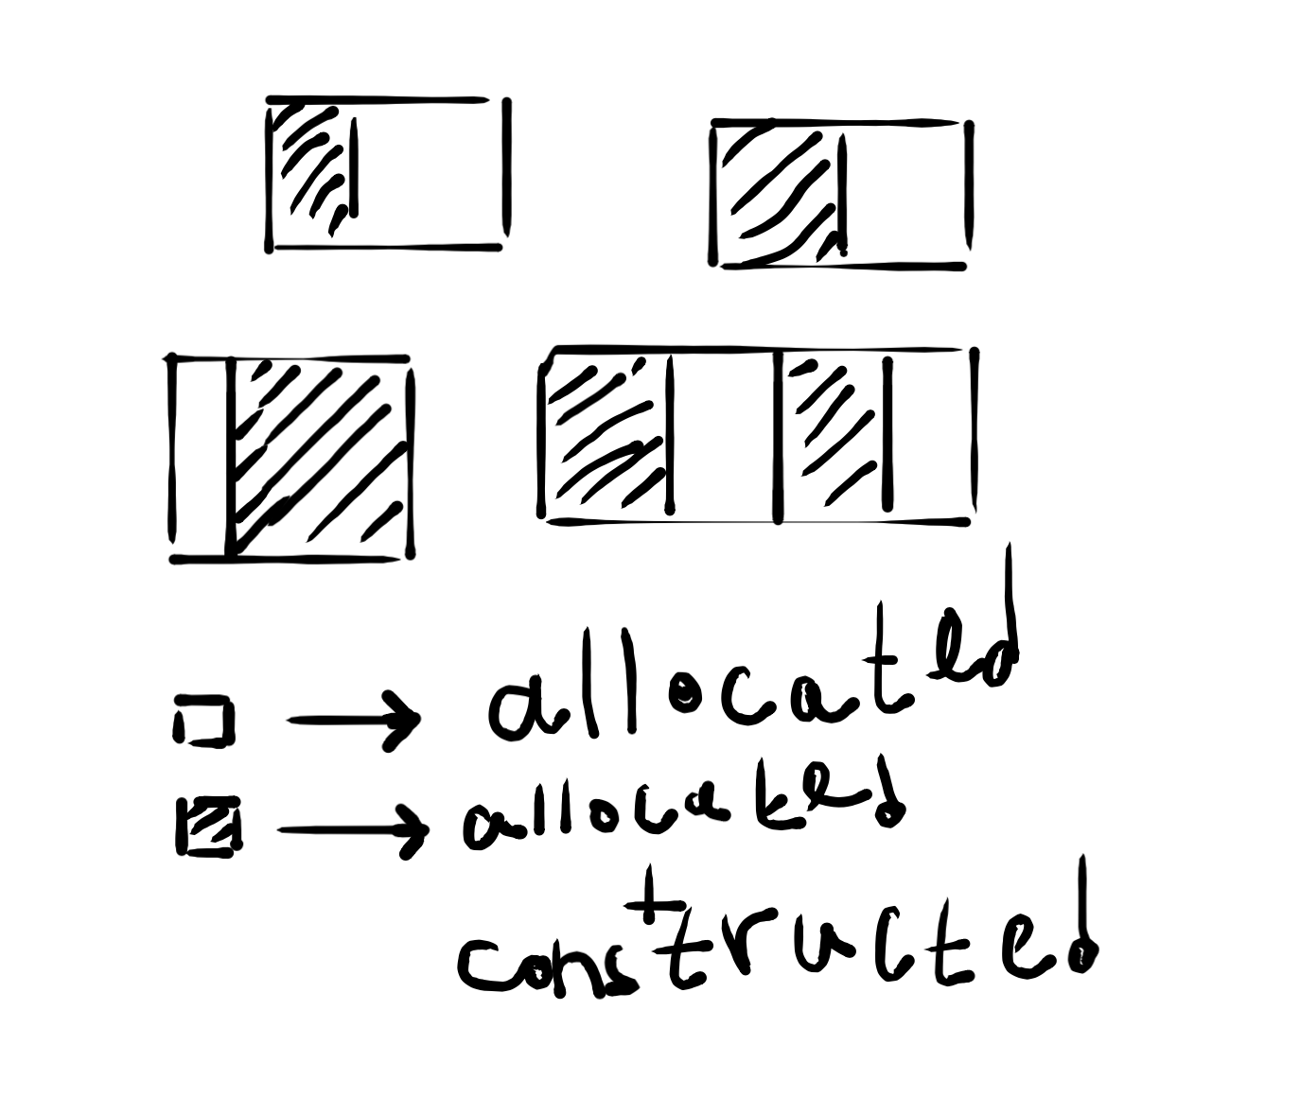
Data and memory management
allocate
construct
destruct
deallocate
Pic.1: lifecycle of the data
When operator new is getting called, operating system tries to allocate requested amount of bytes, and if it fails – throws std::bad_alloc exception.
There is a special version of operator new (nothrow operator new) that doesn’t throw std::bad_alloc when allocation fails, – it returns nullptr instead.
Pic.2: memory management

Slide 5
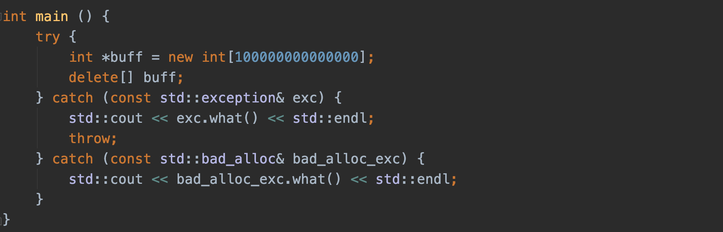
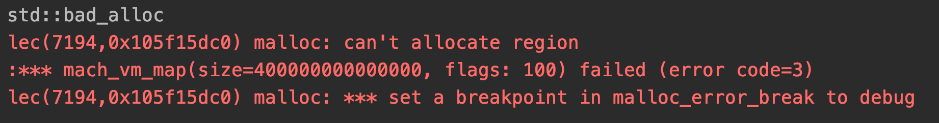
Nothrow operator new
Pic.3: std::bad_alloc() exception
If an allocation fails, – std::bad_alloc() is getting thrown.
We can use special operator (nothrow new) if we want to prevent throwing an error.

Slide 6
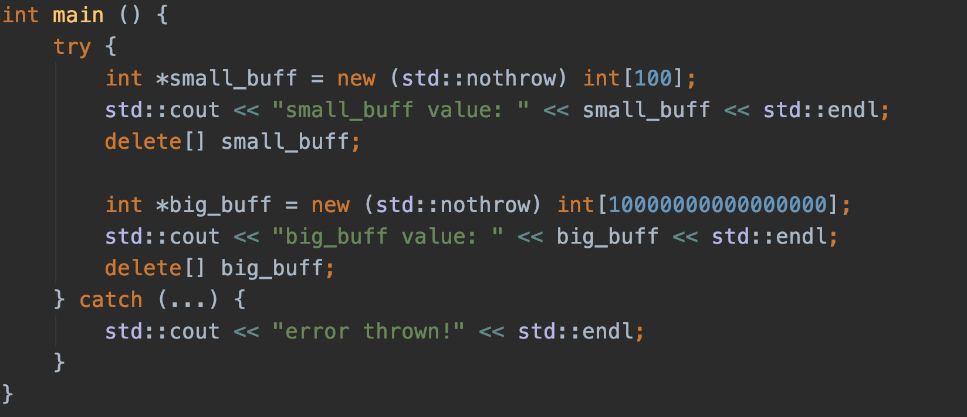
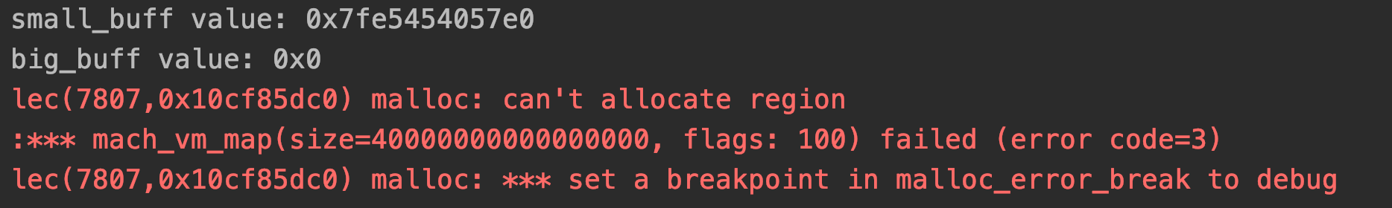
Nothrow operator new
Pic.4: nothrow operator new
In order to call nothrow operator new – you need to provide additional argument “std::nothrow”. It’s just a special value that is used especially for indicating that you want to call a nothrow operator new instead of normal one.
Nothrow operator new doesn’t throw an exception even if an allocation fails, it just returns nulltpr instead.

Slide 7
New and delete: implicitness of behavior
Operator new:
Allocates new chunk of data via operating system call. Size of the chunk is getting calculated with operator sizeof.
Calls default (or non-default) constructor.
Operator delete:
1) Calls destructor.
2) Deallocates the chunk of the data via operating system call.
Operator new[]:
Allocates new chunk of data via operating system call. Size of the chunk is getting calculated with operator sizeof: sizeof(T) * n.
Calls default constructor n times (for every object in the array).
Operator delete[]:
Calls destructor of every object in the array.
2) Deallocates the chunk of the data via operating system call.
– Implicit behavior.

Slide 8
Raw data allocation and deallocation
What if we only want to allocate and deallocate data (without calling constructor and destructor)? How to allocate raw chunk of data?
Use C-functions: malloc and free (not recommended)
malloc receives amount of bytes and returns a pointer to a newly allocated raw chunk of data.
free receives a pointer to the chunk of data and deallocates it.
2) Use operator new[] and operator delete[] with chars in order to allocate and deallocate the data and reinterpret_cast for getting the pointer of the needed type (not recommended, but ok).
3) Use special functions (is recommended and will be demonstrated later in the lecture)
4) Use special classes (strongly recommended and will be demonstrated in the next lecture)

Slide 9
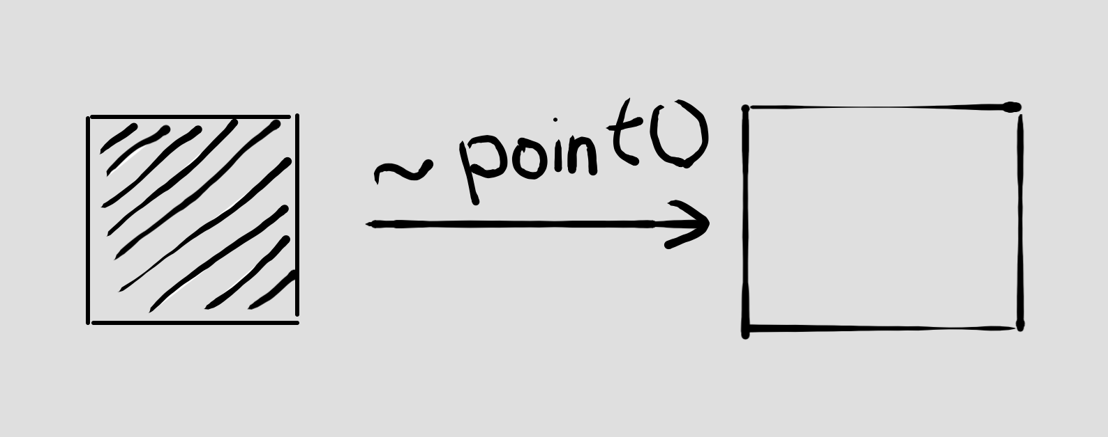
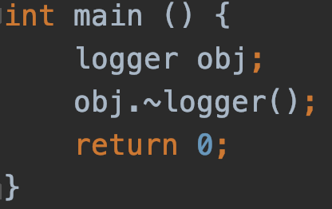
Calling destructor explicitly
Now we’re able to explicitly allocate, deallocate the data. What about destructors and constructors? Lets start from destructor.
Pic.5: calling a destructor explicitly: the chunk of data is not getting deallocated, but it’s getting cleared (now there’s no object inside, but the memory is still reserved and treated as allocated)
Pic.6: calling a destructor explicitly (destructor will be called twice in this example: the second call will be performed by C++ implicitly!)

Slide 10
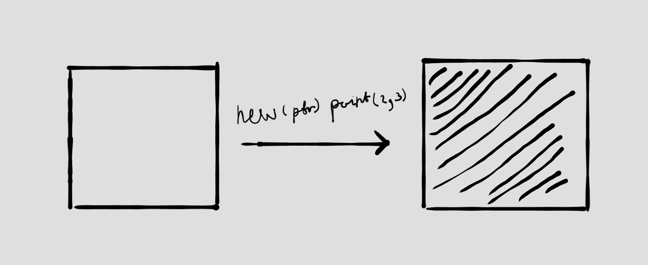
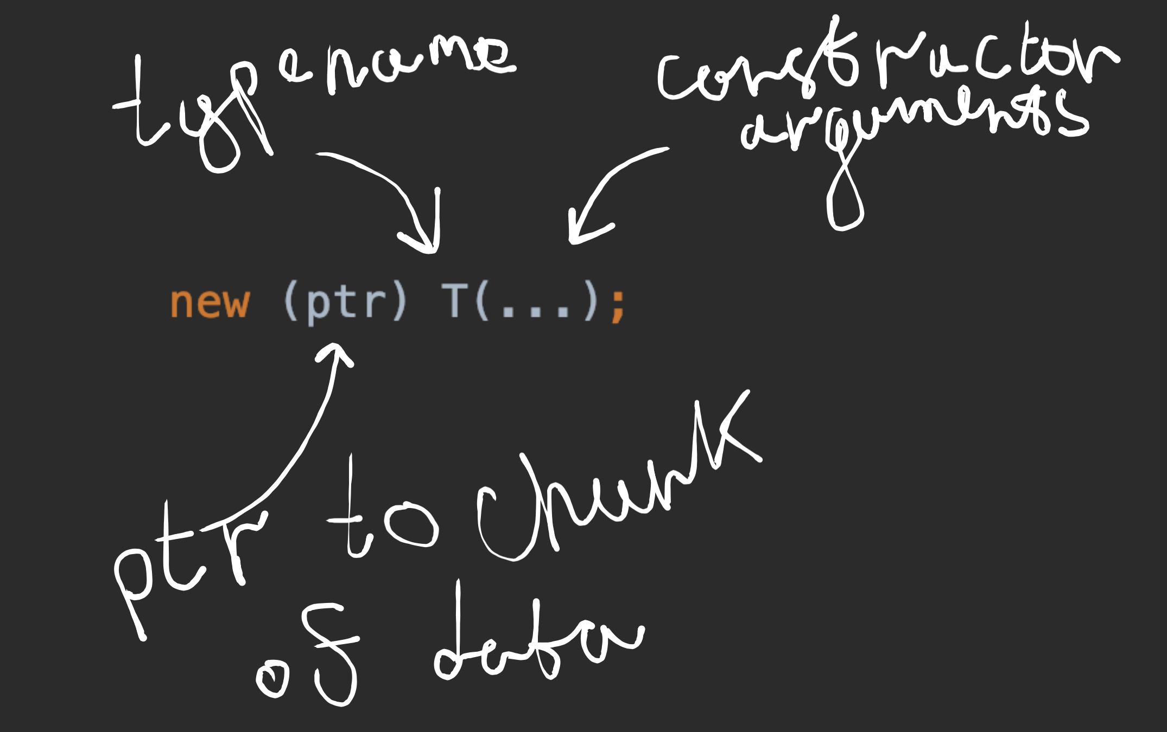
Calling constructor explicitly (Operator placement new)
Operator (placement) new does not allocate the data, it only calls the constructor of an object.
Operator (placement) new receives a pointer to an already allocated chunk of raw data and constructs the object in-place with specified arguments.
Pic.8: calling a constructor explicitly: the chunk of data is not getting allocated, but it’s getting inserted with an object.
Pic.7: operator placement new, syntax

Slide 11
Operator new VS function “operator new”
Every time an Operator new (object form | array form) is called, 2 things happen:
1) Function “Operator new” is getting called.
2) Constructor is getting called (default or non-default one | for the every object in array).
Q: What is function “Operator new” ?
A: It’s an actual function that allocates memory for your object when Operator new is getting called.
Q: How to explicitly call function “Operator new” ?
A:
There are specified versions of function “Operator new” for every type of Operator new: 1) Operator new
2) Operator new for array
3) Placement operator new
4) Placement operator new for array
5) Nothrow operator new
6) Nothrow operator new for array
...

Slide 12
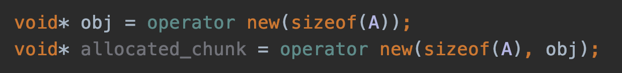
Signature of function “operator new”
Pic.6: Signatures of function “Operator new”
Standard function “Operator new”. It’s getting called by standard operator new. It receives an amount of bytes that needs to be allocated.
Non-throwing function “Operator new”. It’s getting called by non-throwing operator new (will be discussed later in the lecture).
Placement function “Operator new”. It’s getting called by operator placement new. Compared to standard function operator new, this version receives one additional argument – a pointer to the chunk of data where an object should be constructed.
Pic.9: calling function “operator new” for allocating memory and then function “operator placement new” for constructing an object with default constructor

Slide 13
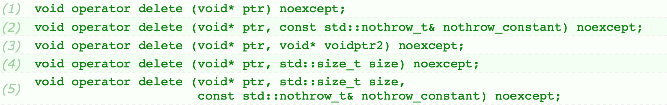
Signature of function “operator delete”
Every time an Operator delete (object form | array form) is called, 2 things happen:
1) Destructor (of object | of every object in the array) is getting called.
2) Function “Operator delete” is getting called.
Pic.10: Signatures of function “Operator delete” for array
1-3) Corresponding versions of function “Operator delete” (see previous slide).
4) Standard version with additional argument – size
5) Nothrow version with additional argument – size.

Slide 14
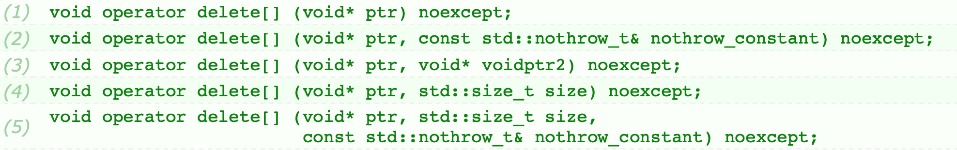
Array versions of function new and delete
Pic.11: Signatures of function “Operator new” for array
Pic.12: Signatures of function “Operator delete” for array
As you can see – these functions have the same signatures as single-object versions

Slide 15
Replacing functions “operator new” and “operator delete”
Motivation: you may have some additional information to help you to establish the most optimal allocation strategy for your program.
There is no way to overload operator new and operator delete themselves.
All of the versions of function “Operator new” and function “Operator delete” can be replaced with the user-defined versions except the built-in function operator placement new.
RULE: if you replace operator new, you should also provide an overload of operator delete that receives the same additional arguments as new.
There’s no way to replace standard function operator placement new, but there is a way to provide your own version of a function operator placement new. It’s called a user-defined function operator placement new.
In order to do that, you should define a function operator new that’ll receive bytes count as first argument as always and other specific for you arguments. You’ll need to implement an analogue version of function operator delete in order to preserve the rule above.

Slide 16
A more meaningful example
Suppose that you’re developing a program that allocates 1000000 small objects in the loop, works with them, destroys them.
If we’ll use the standard operators new and delete – it’ll cause a big fragmentation of the memory. Allocated chunks of data won’t be structured efficiently because interpreter can’t predict the most efficient way for allocating our objects. But we can.
For example, we can provide our own version of operator new and delete that’ll be allocating 1 big chunk of data and manage it’s resources during the execution of the program.

Slide 17
Interface of memory allocation mechanism
Basic methods
Allocate: allocate raw chunnk of data (with operator new or malloc for example).
Construct: call the constructor explicitly (with operator placement new for example)
Destroy: call the destructor explicitly
Deallocate: deallocate chunnk of data (with operator delete or free for example).
How to implement interface?
1. Use function operator new, function operator delete, implicit calls of constructors and destructors
Bad. This forces the programmer to independently use rather difficult functions from time to time.
2. Create a class with 4 described methods. Let’s call it allocator.
Good. This allows programmer to use a simple class in order to manage memory and work with it.

Slide 18
Std::allocator
It’s a built-in template class that implements an “allocator” pattern.
It’s defined in the <memory> header.
Member types
Member functions
value_type
size_type
difference_type
other ones (deprecated in C++17, removed in C++20)
allocate
deallocate
construct (deprecated in C++17, removed in C++20)
destroy (deprecated in C++17, removed in C++20)
other ones (deprecated in C++17, removed in C++20)
Some member types and methods were removed from the class, as they are typical not only for std::allocator, but also for any user-defined allocator. Now all these typedefs and methods can be found in the std::allocator_traits class

Slide 19
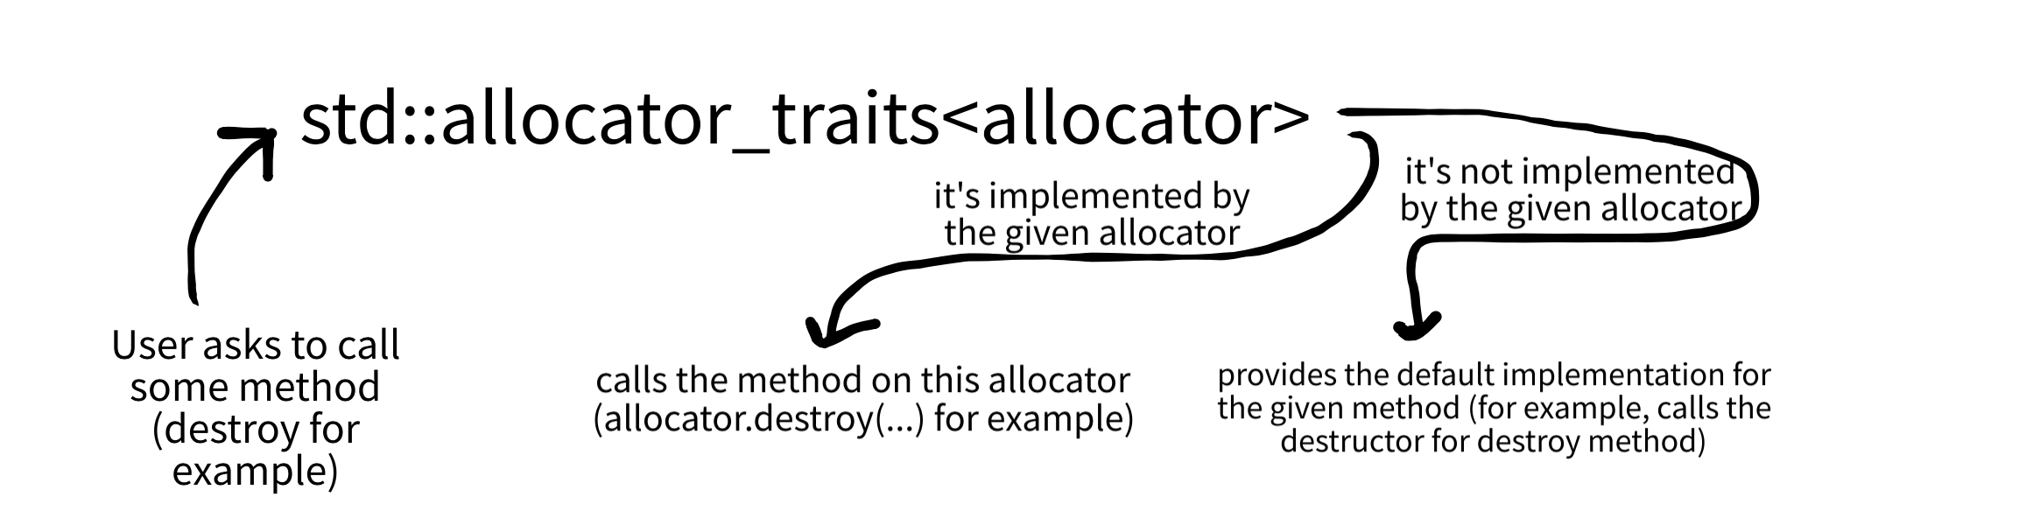
Std::allocator_traits
The allocator_traits is a template class that provides the standardized way to access various properties of allocators.
It’s a template class with only one template parameter – type of the allocator.
This class provides default implementations of methods such as construct, destroy and others for the given allocator if these methods weren’t defined on the given allocator itself. std::allocator_traits wraps the provided allocator and provides definitions for missing methods.
Provided allocator must have methods allocate, deallocate and typedef value_type in order to be compatible with std::allocator_traits.
pic1: std::allocator_traits: how it works

Slide 20
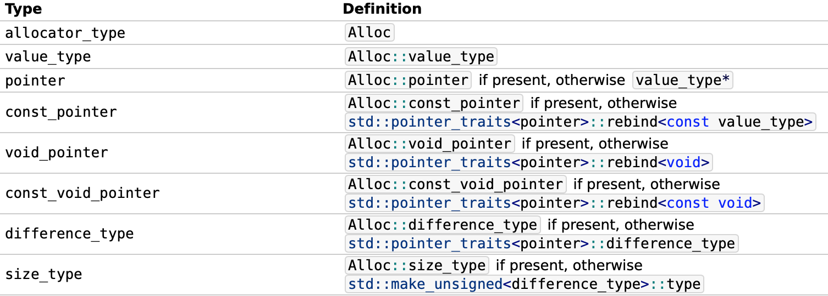

Std::allocator_traits: typedefs
4 more …
pic2: std::allocator_traits: typedefs

Slide 21
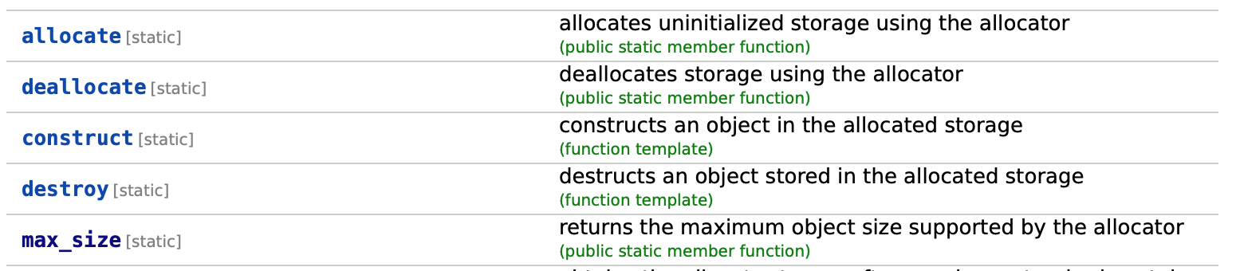
Std::allocator_traits: methods
1 more …
pic3: std::allocator_traits: methods
allocate – calls allocator::allocate(…)
deallocate – calls allocator::deallocate(…)
construct – calls allocator::construct(…) if presented, otherwise calls constructor explicitly with operator placement new.
destroy – calls allocator::destroy(…) if presented, otherwise calls destructor explicitly.
max_size – calls allocator::max_size() if presented, otherwise returns std::numeric_limits<size_type>::max() / sizeof(value_type)

Slide 22
Std::allocator_traits: how to get typedefs
Let’s suppose that you want to get a const pointer field of an allocator.
1. Wrap your allocator type with std::allocator_traits: std::allocator_traits<your_allocator_type<your_data_type>>
2. Access the const_pointer field of the type that you’ve got at step 2. Because it’s static, you can call it without making an instance of class std::allocator_traits:
std::allocator_traits<your_allocator_type<your_data_type>>::const_pointer
Hint: you can use typedefs in order to make code clearer:
typedef std::allocator_traits<your_allocator_type<your_data_type>> alloc_traits;

Slide 23
Std::allocator_traits: how to call methods
Let’s suppose that you want to call an allocate method.
1. Create an instance of allocator that will be used for calling an allocate method.
2. Wrap your allocator type with std::allocator_traits: std::allocator_traits<your_allocator_type<your_data_type>>
3. Access the allocate method on the type that you’ve got at step 2. Because it’s static, you can call it without making an instance of class std::allocator_traits:
std::allocator_traits<your_allocator_type<your_data_type>>::allocate(…)
4. For allocate method, you should provide an instance of an allocator first, and then, provide arguments for allocate method of allocator itself:
std::allocator_traits<your_allocator_type<your_data_type>>::allocate(alloc, n)

Slide 24
Custom allocators
What’s wrong with malloc/free and operators new/delete?
General purpose
Slow
Fragmentation
Whats the benefits of using custom allocators?
Low number of mallocs
Data structures
Constraints

Slide 25
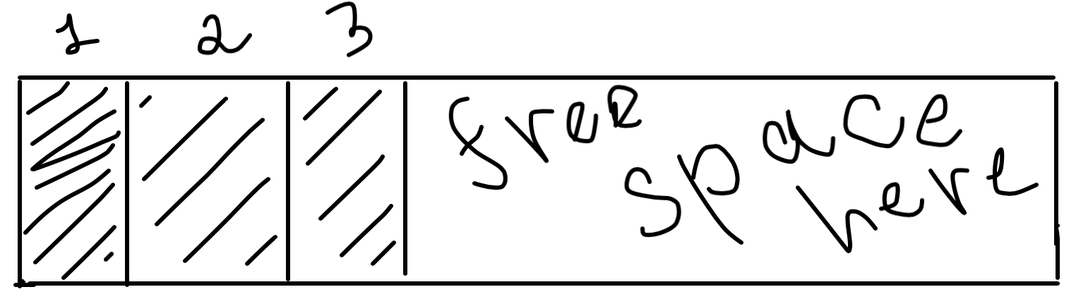
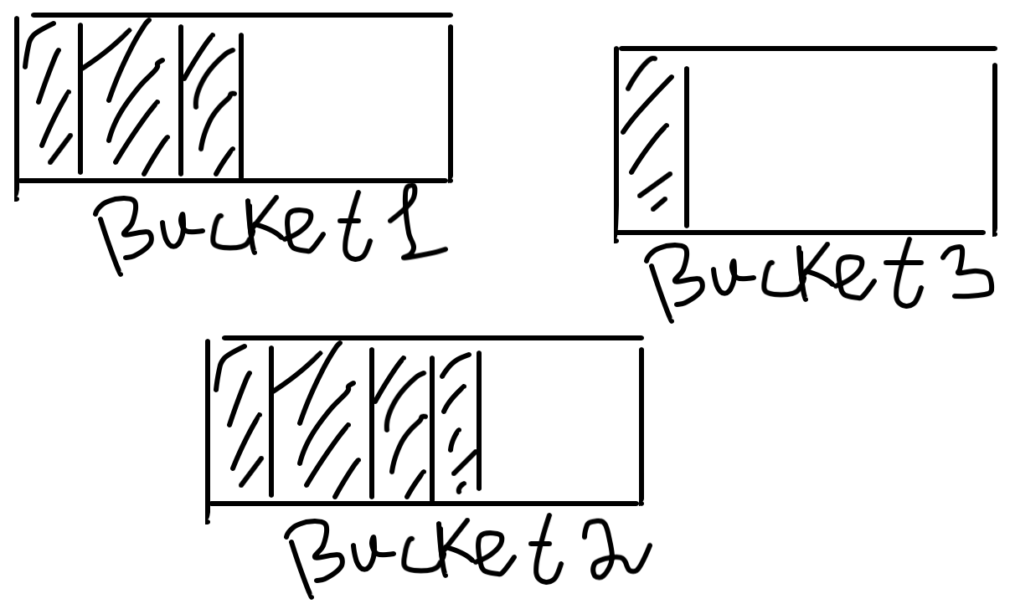
Custom allocators: examples
1. Linear allocator: preallocates a big buffer in the constructor and deallocates it in the destructor.
+ calls operator new and delete only once.
+ no memory fragmentation.
pic4: linear allocator (3 allocations were already performed)
+ allocations and deallocation in an O(1) time
– memory won’t be freed before destruction of the allocator, so it can’t be reused.
– memory chunk is limited by the size of the buffer.
2. Bucket allocator: stores the data inside buckets (buffers with lower size limit) and manage them during the lifetime.
+ calls operator new and delete a few times.
+ small memory fragmentation.
– allocations and deallocations in an O(buckets_amount) time
pic5: bucket allocator
+ memory chunk is not limited by the size of the bucket.
+ memory will be freed when a certain bucket will be freed, so it can be reused again and again.

